Slide 1
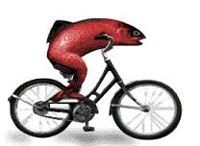
A woman needs a man like a fish needs a bike…
The Feminist Movement

Slide 2
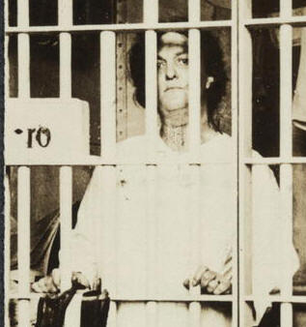
The bonds of womanhood
Mid-1800s: The Bonds of Womanhood (Nancy Cott)
Idea that women were “trapped”
By domestic roles in the home
Under paid, long hours, horrid working conditions in factories
If educated, were limited in what positions they could hold (making less money)
SOLIDARITY in their plight

Slide 3
Solidarity:
is unity (as of a group or class) that produces or is based on collective interests, objectives, standards, and sympathies. It refers to the ties in a society that bind people together as one.

Slide 4
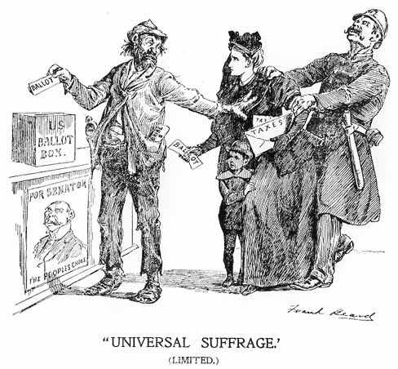
Activism leads to Organizing
Sarah Grimke’ (1830s) “I ask no favors for my sex. I surrender not our claim to equality. All I ask of our brethren is that they will take their feet from off our necks, and permit us to stand upright...”
Women rights activists were typically part of the Abolitionist and Prohibition movements
No right to vote
No right to her own wages or property
No rights in divorce cases
No equal employment opportunities
No entrance into colleges

Slide 5
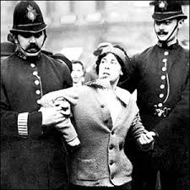
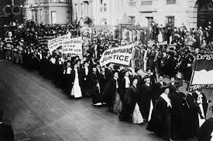
Women’s rights
Women involved in anti-slavery movements
Resented men taking leadership roles
Sarah and Angelina Grimke
Letter on the Condition of Women and Equality of Sexes (1837 – Sarah Grimke)
1848 1st suffrage movement: Seneca Falls Convention
Declaration of Sentiments
“all men and women are created equal”
List of grievances
National American Woman Suffrage Association (1890)
Formed when 2 suffragist organizations merged
Elizabeth Cady Stanton and Susan B. Anthony
1870 Anthony tried to vote, filed a lawsuit and lost
1872 did vote, arrested and 1 night in jail
Lucy Stone
2m members under Carrie Chapman Catt
19th Amendment passed 1919

Slide 6
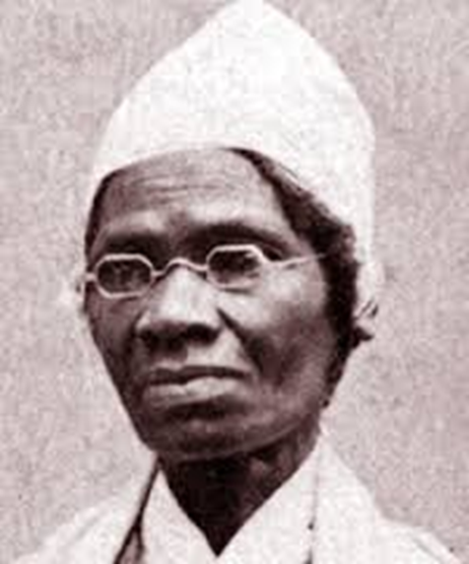
Abolitionists
Sojourner Truth, Harriet Tubman
“Ain’t I a Woman?”
Aint I a woman?

Slide 7
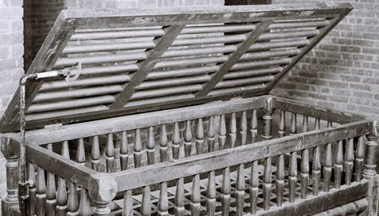
Asylum reform
Mental hospitals
People with disabilities
Dorothea Dix
Spoke to MA Legislature after touring hospitals for insane, prisons, almshouses, workhouses (started 1841)
Conditions for sick and insane: “cages, closets, cellars, pens!” (warehousing vs. care)
Dr. John Galt
Eastern Lunatic Asylum (Williamsburg, VA)
1st psychiatric hospital in US
Talk therapy
Drugs
Outpatient vs. lifelong

Slide 8
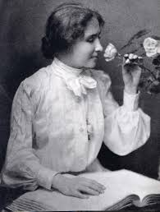
She must be a communist…
Early 1900s:
Socialist women were very active: saw flaws in the Socialist Utopia: once economic barriers were gone, sexism would remain
Image of women as wives/mothers prevailed
Key activists:
Jane Adams – Hull House
Emma Goldman (union leader and child labor activist) and Helen Keller wanted MORE than just the vote
Margaret Sanger – 1st birth control clinic

Slide 9
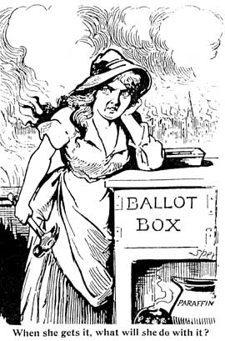
Suffrage
U.S Constitution – 1787 (ratified 1789) – no specific definition of “citizen”
Caucasian, land-owning male
Literacy tests
Property ownership
14th Amendment (1868): Born or Naturalized = Citizen
15th Amendment (1870): Cannot deny based on race or color
19th Amendment (1920): Cannot deny based on sex

Slide 10
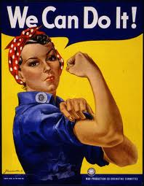
Post 1920: did the position of women change?
Lynd’s Middletown study found that men viewed women as purer than men, but emotional and impractical
1930s – Boom in beauty business
WWII – Women were a necessary, large segment of the work force
1960, 36% of women worked
Median income was 1/3rd of a man’s

Slide 11
1960s
- Civil Rights activism
- Anti-War activism
Women were on the front lines
Women began organizing for their own rights

Slide 12
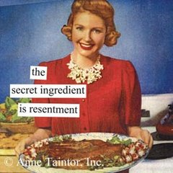
The feminine mystique
Betty Friedan spoke up about how middle class, educated, white women really feel:
Tired
Defined by the household
Hidden frustration, depression
Mystique – image of woman as wife, mother
Living through husband and children
Dissatisfaction
Keep quiet – can’t speak about “the problem”
Other women came out and admitted to feeling the same way
Collective feeling/not alone

Slide 13
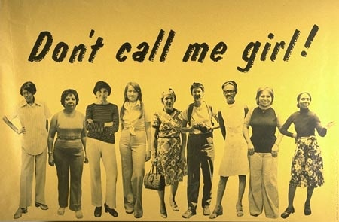
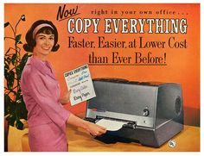
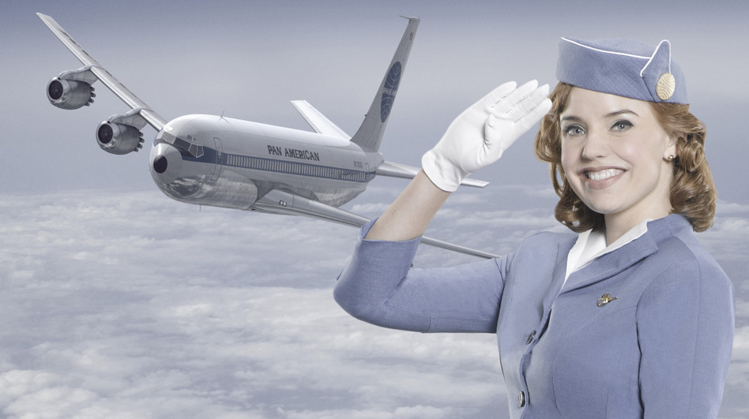
“The only way for a woman, as for a man, to find herself, know herself as a person, is by creative work of her own.” – Friedan
1969 – women made up 40% of the labor force, but in low paying jobs
Rest worked at home, but not considered “work” because not paid - living outside of the economic system (serf)
Jobs were subordinate positions (before sexual harassment laws)

Slide 14
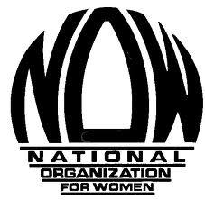
Women’s liberation!
Women rethink their roles, reject inferiority, build solidarity
1963 Equal Pay Act (same job, same pay)
1966 National Organization for Women (NOW) forms (Friedan) and files 1000+ suits against US corporations for discrimination
1967 President Johnson: executive order banning sex discrimination in federal jobs

Slide 15
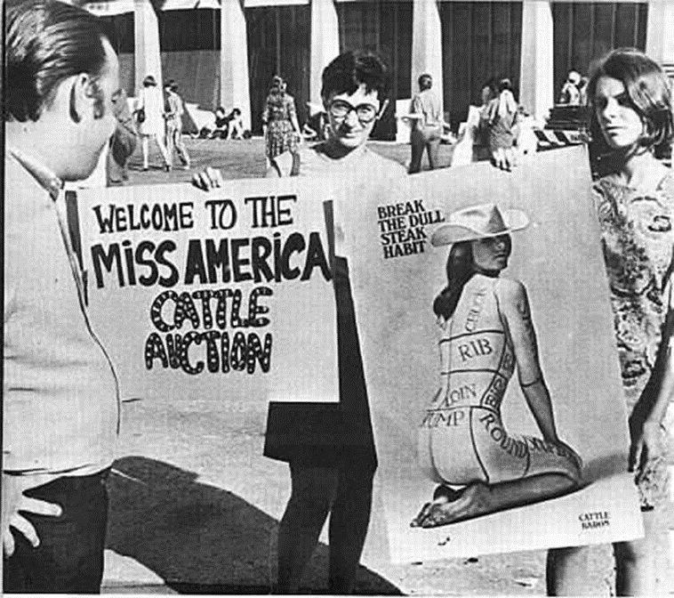
1968 Miss America Pageant: Radical Women protested “an image that oppresses women”
Freedom Trash Can – burned bras, curlers, false eyelashes, etc.
Term “Women’s Liberation” was out in the open and gaining momentum

Slide 16
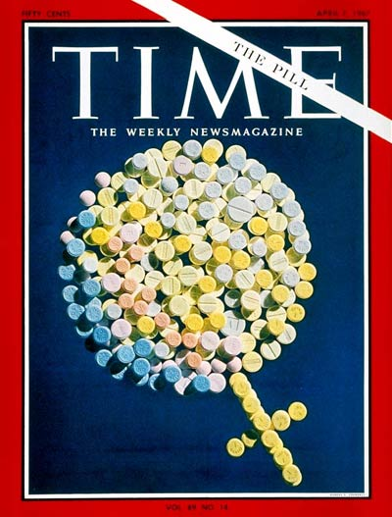
Women’s bodies are their own…
1960- The Pill: Women can control reproduction – more women can work, work longer and put off having a family or not have one at all.
Abortions pre-1973: est. 1 mil/yr; 10k legal
1/3rd of illegal abortions (majority were women in poverty) were hospitalized for complications
Roe v. Wade (1973): states can only prohibit abortions in the last 3 months
States can regulate for health purposes in 2nd trimester
Woman and doctor had the right to decide in 1st trimester
Push for childcare centers
Rape was talked about openly
Increase in self-defense classes

Slide 17
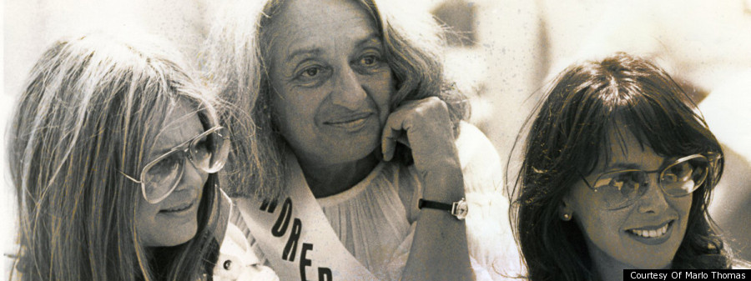
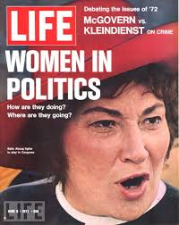
The Players
Betty Friedan: “Old Guard” feminist; founded NOW
Gloria Steinem: “New Guard” feminist; more radical and pro-active; founded Ms. Magazine
Bella Abzug “A woman’s place is in the House. The House of Representatives.” Congresswoman, women and gay rights activist
Germaine Greer: (Marxist and Australian) Women’s liberation is not equality with men, but to embrace their differences. It’s about self empowerment and opportunity.
National Women’s Political Caucus: supports women running for office

Slide 18
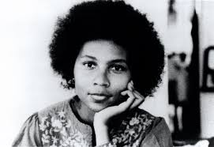
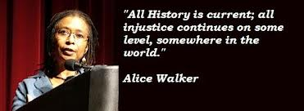
There is more to this…
Feminism was centered around white women and their “right” to work
Black women had been working all along
Black women were not on the front lines of the movement
So they started their own:
Mary Ann Weathers, Alice Walker, bell hooks, Angela Davis, Patricia Hill Collins
National Black Feminist Organization 1973-77

Slide 19
History of push back
There have always been women who felt that their place was in the home. A woman’s domain was caring for her family and fulfilling domestic duties.
Feminism is an “attack” on the family
1972 – Phyllis Schlafly (conservative anti-feminist lawyer) former STOP ERA on the grounds that if it passed, women could be subject to conscription
Equal Rights Amendment was written in 1923; introduced to Congress 1972 and has not been ratified after numerous attempts, rescinded votes and expired deadlines
guaranteed women’s rights
The Pill is seen as endangering society by controlling child birth
Roe v. Wade:
Moral and religious reasons for not supporting
question of “life” and “killing”

Slide 20
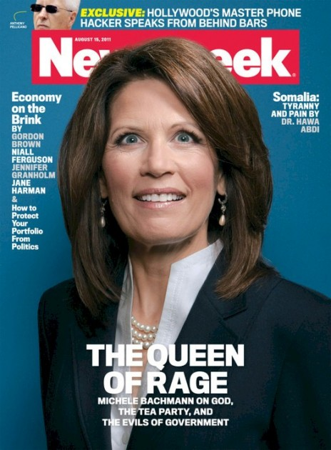
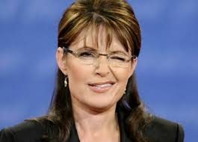
Anti-feminism

Slide 21
Today
https://www.youtube.com/watch?v=S5pM1fW6hNs&index=9&list=PLpiEH3_VexzFJ9V5D4ALZ72uy2qGodBS0
https://www.youtube.com/watch?v=LszYkRyHRZg&list=PLpiEH3_VexzFJ9V5D4ALZ72uy2qGodBS0

Slide 22
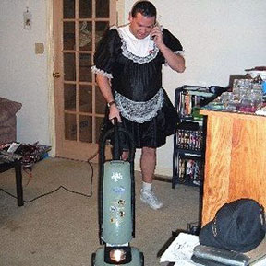
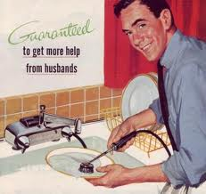
New (Old?) battles today:
"We've demonstrated that women can do what men do, but not yet that men can do what women do. That's why most women have two jobs—one inside the home and one outside it—which is impossible. The truth is that women can't be equal outside the home until men are equal in it.” – Steinem
Women work the same hours as men outside of the home; women do the majority of the work in the home.
1960s women performed 32 hours of housework/wk vs. men doing 4
2000 women perform 19hrs to men’s 10

Slide 23
The poverty gap = the gender gap?
Gender pay gap – men occupy jobs that pay more
Glass-ceiling – men move up to higher positions disproportionately more than women (even though more women are in college and more are earning higher level degrees)
Women represent 50% of the U.S. population but only represent 16% in politics; U.S. ranks 68th out of 189 countries in women’s political representation (UNDP)
Single-mother households with children under 5: 49% live below the poverty line in Wisconsin vs. 4.7% for married couples with children under 5
Women make up 60% of the world’s working poor (50% of the wealthiest women in the world are in China!)

Slide 25
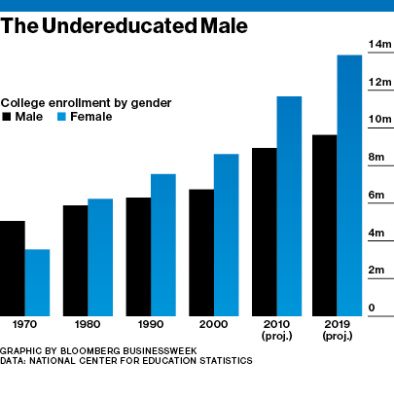

Slide 26
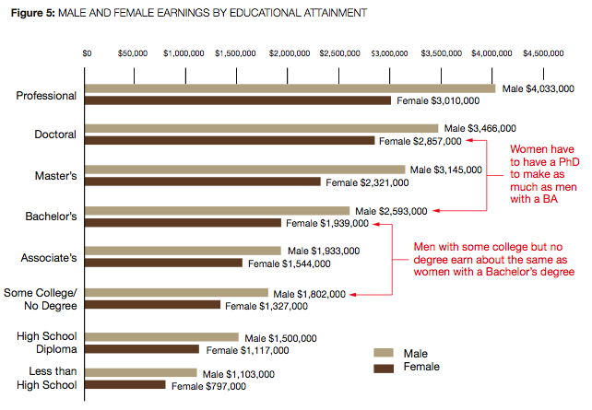

Slide 27
