Slide 1
US History 2nd Semester
WHS Mrs. Ennis 2015

Slide 2
Review
Some terms:
Primary and secondary sources
Reflection
Context
Interpretation
Bias and Perspective

Slide 3
Progressives
Who were they?
Middle class, educated (some religious)
Response to urbanization, immigration and industrialization
Anti-corruption in local governments
Goal?
Social justice

Slide 4
Progressives & Populists: both want social and government reforms
Progressives
Populists
Middle class
Educated
Religious motivations
Focus on urban areas
Farmers
Workers
Work conditions
Interstate commerce

Slide 5
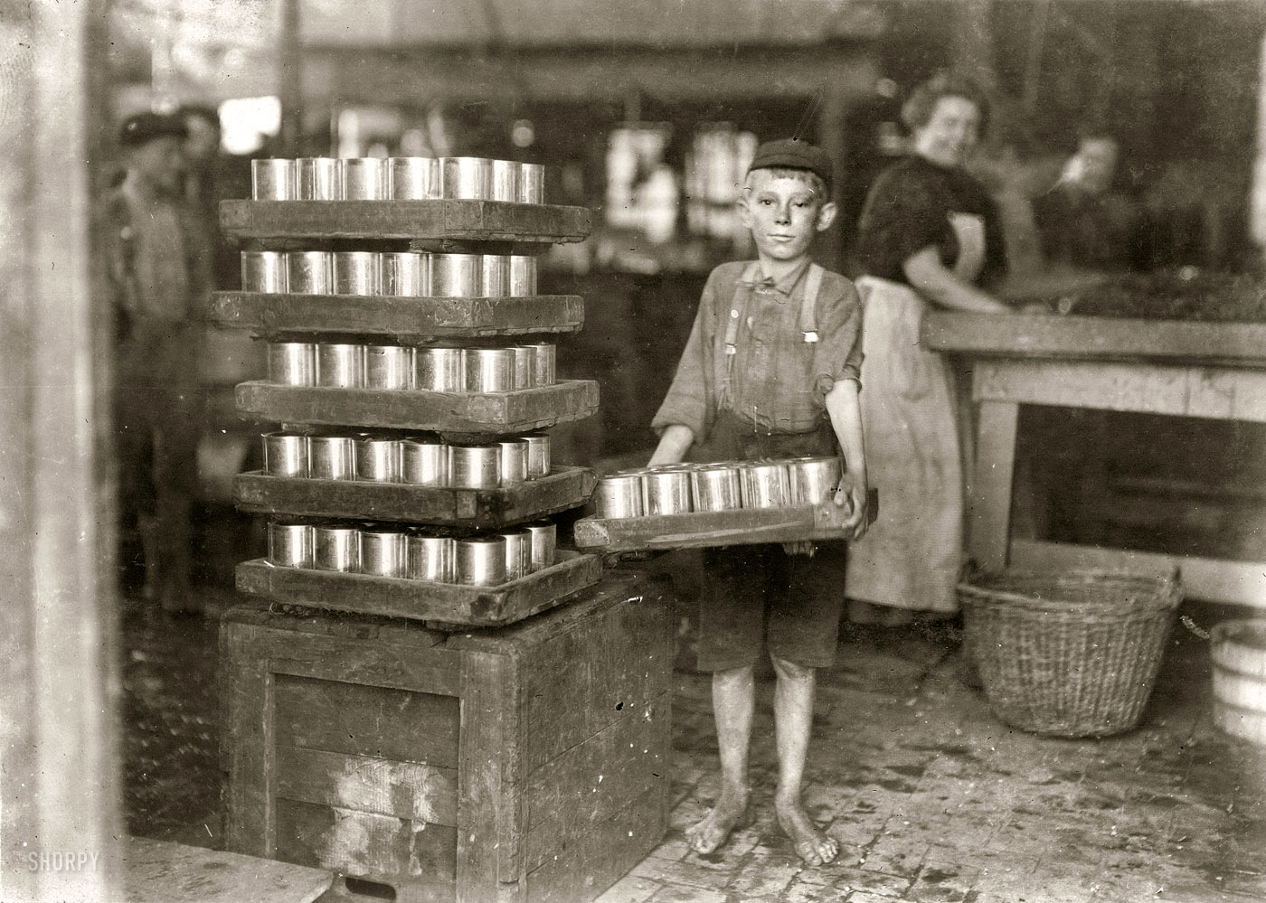
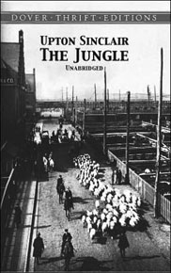
“Muckrakers”
Socially conscious journalists
Also saw Progressivism in fiction

Slide 6
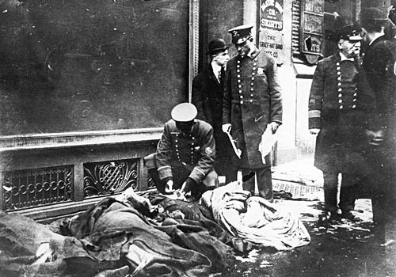
Government Reforms
Education and Children
More public schools
Child labor laws
Women
Suffragists
Temperance
Labor laws
Triangle Shirtwaist Factory (NY)
Fire: 146 women died because of unsafe conditions

Slide 7
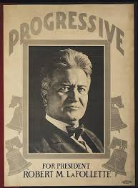
Elections
WI Governor Robert LaFollette
“Direct Primary” elections
Initiatives: citizens can propose new laws on ballot with petitions
Referendum: citizens can okay laws passed by legislators
Recall: citizens can remove a public official

Slide 8
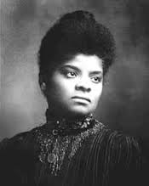
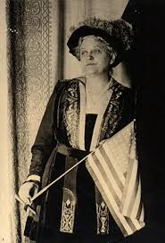
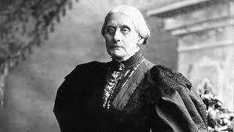
Women
Suffrage
14th Amendment says that states can’t block the rights of citizens. i.e. the right for women to vote
19th Amendment: the right to vote can not be denied on account of sex
Women opponents claimed would hurt family life
Susan B. Anthony
Carrie Chapman Catt
Ida Wells

Slide 9
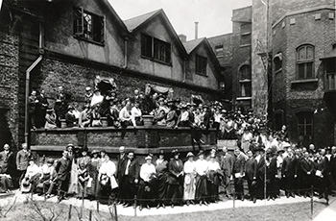
Discrimination with progressives
Settlement Houses: run by middle class women
Classes in English and “Americanization”
Provided services for poor, especially women and children
Immigrants were frequently beneficiaries
Goal to assimilate
Immigrants (poor, possibly Catholic, own cultures were different than here)
Scientifically “justified” racism – based on “science” of the time
Plessy vs. Ferguson: Separate but equal
Not just against Blacks, but also a hierarchy of immigrants

Slide 11
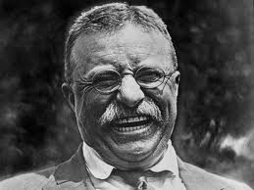
Teddy Roosevelt
Square Deal:
Keep the big businesses in check
Not everyone is dealt the same hand
Up to each person to do the most he can with it
But the deck should be fairly dealt
Targeted Trusts: Dept of Commerce and Labor
Mines
Railroads
Environment:
Federal lands
Water control

