Slide 1
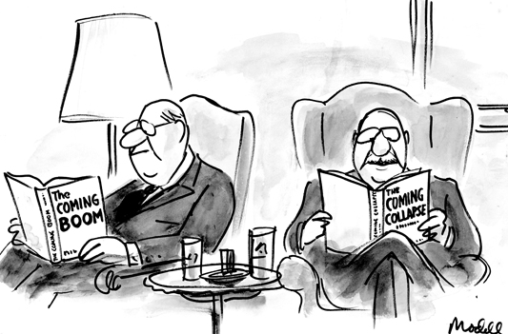
Boom…and Bust
The “Roaring ’20s” set itself up for The Great Depression

Slide 2
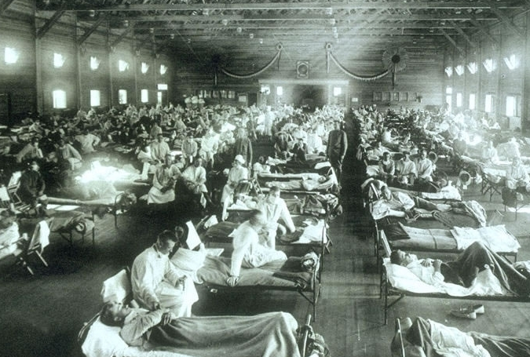
Let’s Set the Stage:
Going into the ’20s
WWI
Reparations for German
Economy suffering in Europe
Flu Pandemic in the U.S.
Movement of purging society of “anti-American” influences
Immigration

Slide 3
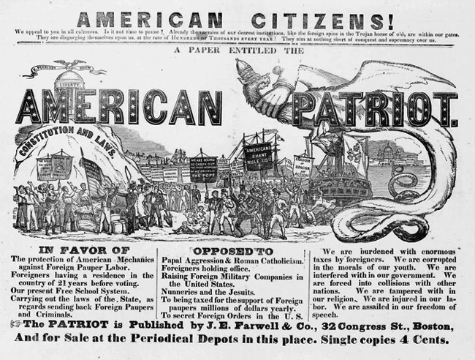

Slide 4
The good...
Living Longer!
Increase in medical discoveries
Better health care
Better nutrition
Educated!

Slide 5
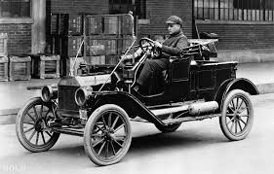
And Ford made it even better!
Mass production = mass consumption
Applied Scientific Management System to industry = efficiency
“Fordism” = Model T: Cheap, Tough, Rough… AND STANDARDIZED
1914: 500,000th rolled off the line
1930: 20,000,000th
Chain reaction
“Car Culture” impact
Youth
Crime
Schools

Slide 6
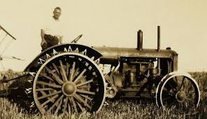
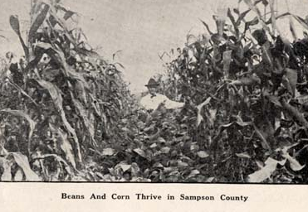
This could never end!
Assembly line production, new technology
In farming
Tractors, harvesters, trucks
Cultivate more land
Bring produce to market fast
Sell more
War meant Government set the price/bought for war
Eventually a bust:
Over production
War economy done
Crops worth less/less demand

Slide 7
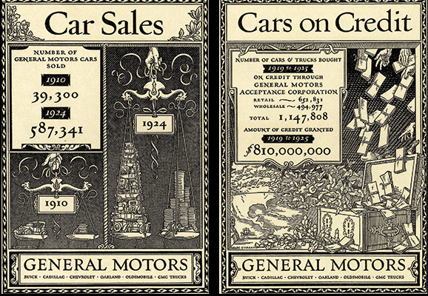
Buy today, pay tomorrow (or never)
CREDIT!!!
New consumerism
Production methods lead to more things available for more people (cheaper)
Vulnerable economy

Slide 8
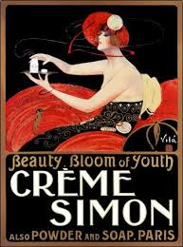
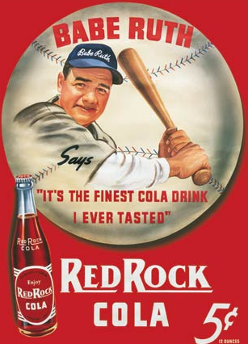
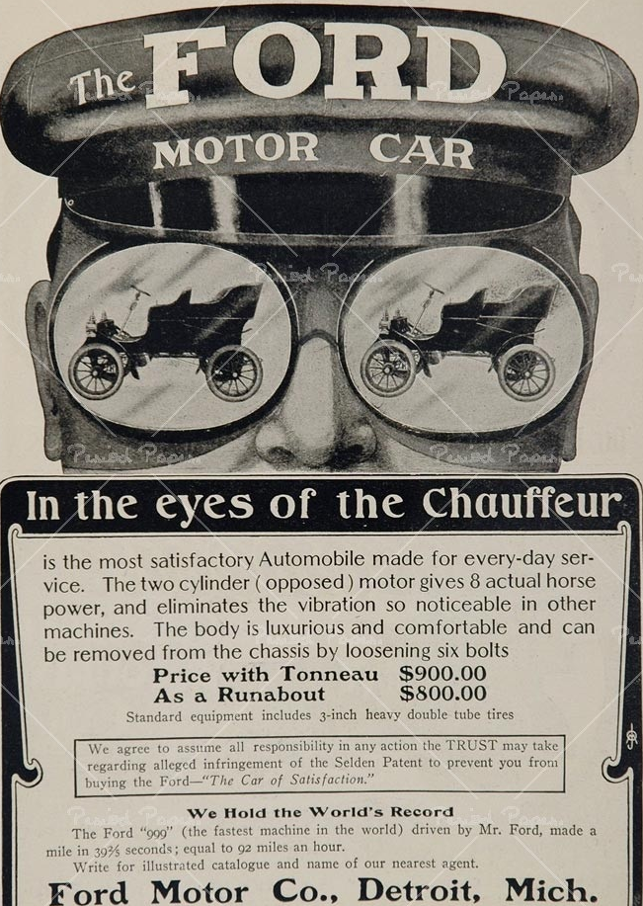
ADVERTISING!
New industry
Happiness = new stuff
Created image of what life “should” or “could” be
Credit made it happen

Slide 9
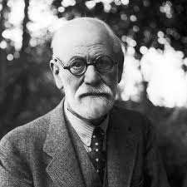
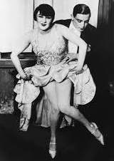
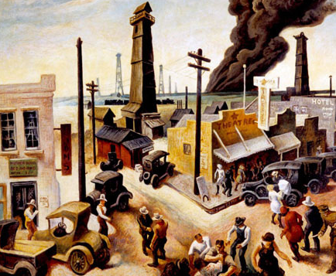
Party time
Freedom!
Cars
Advertisements
Freud
Sexual repression = nervousness and emotional problems
Jazz
Modernism in culture
Breaking away from convention
Criticizing social conventions
H.L. Mencken
Pitfalls of social climbing/”Old Guard”

Slide 10
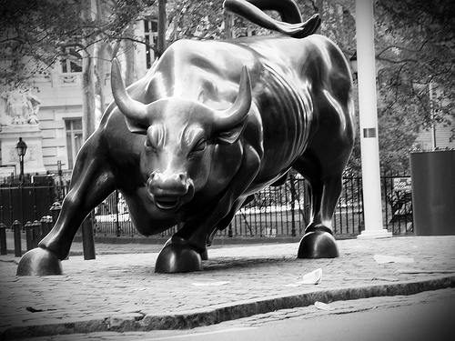
Riding the Bull… feeling the flow
Bull Market: prices will rise
BUY
Real estate speculation
Florida
Availability of credit
Less saving, more spending = recipe for a crash

Slide 11
Hot tips!
Stock market
Speculation
Gambling
“On the Margin”
Hot tips
Rags to riches

Slide 12
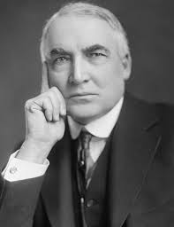
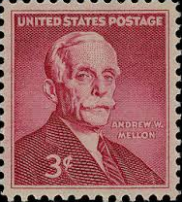
Who’s in charge?
Republican Warren G. Harding elected
Ohio Gang
Wilson had increased debt during war
? How do we pay it off?
1921 Bureau of Budgets created
Aided President with budget
Andrew Mellon as Secretary of the Treasury
Multimillionaire industrialist
Reduce taxes on rich = reinvest in capital = expand economy
High taxes = investing in tax exempt securities
But WHO IS going to pay the bills??
1921 $1M in income = $663K in income taxes
1926 $1M in income = $200K in income taxes

Slide 13
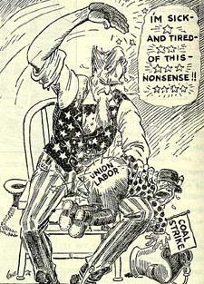
Progressives regressed
Pro Business means
Stripped labor rights
Strikers labeled as “reds”
Vetoed child labor bills
Women got vote so they didn’t need special treatment
Big industry trade associations
Set prices
Unions undermined
War Industries Board disbanded
Railroad private again

Slide 14
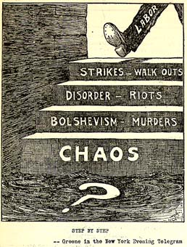

Slide 15
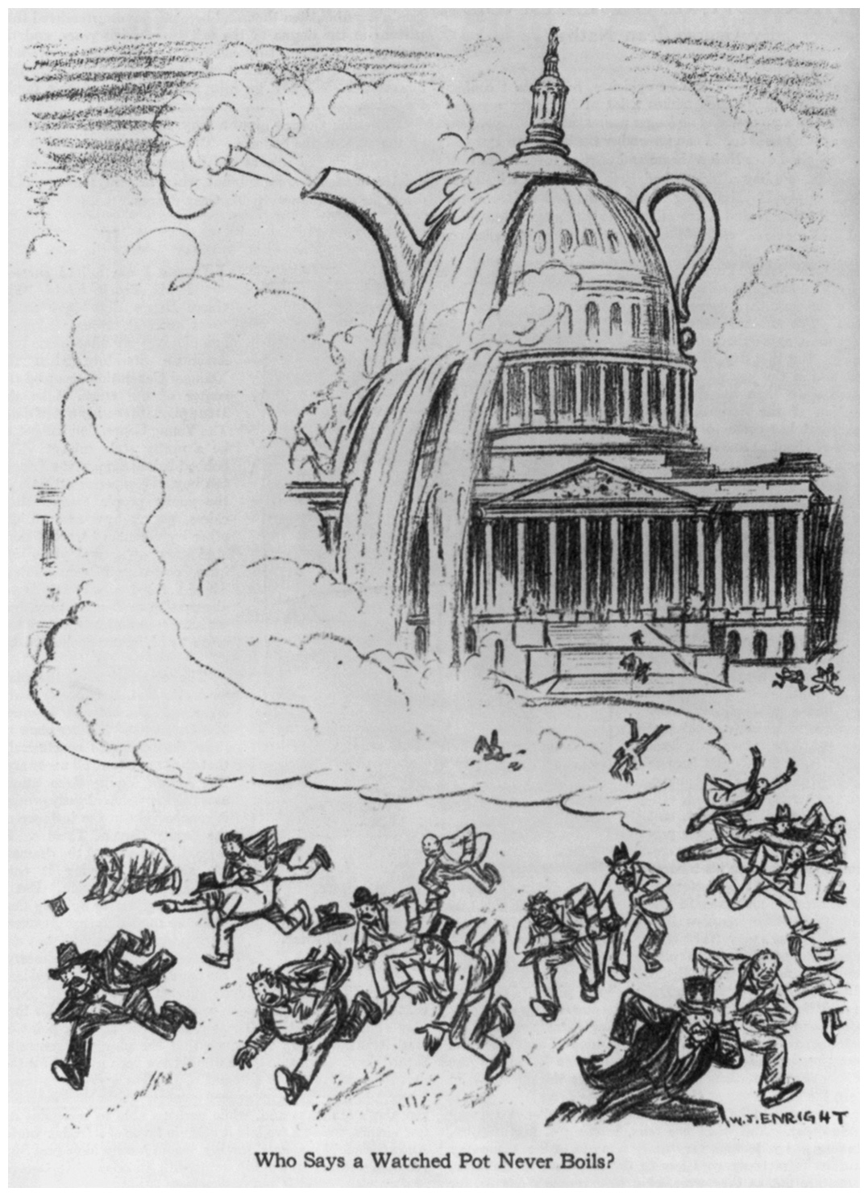
I’m a little Teapot.. Short and crooked!
1923 Colonel Forbes
Forced to resign as head of Veterans Bureau
Embezzled $200M
1921 Teapot Dome Scandal
Secretary of the Interior Albert Fall
Took “Loan” from competing oil men who wanted to lease land that belonged to the Interior Department

Slide 16
Dominos?
Ripple effect
Middle class took on tax burden
Mellon indirectly encouraged Bull Market
Instead of absorbing additional income, spending it on speculation

Slide 17
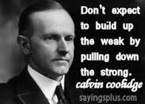
Coolidge takes the Reins
Harding dies of repertory failure
Calvin Coolidge
Harding had been more of a push-over
Old Guard wanted hands off government, but government aid in profits
“Boring”
Status quo
Pro-business/fan of Mellon

Slide 18
Keep away
International relations
Arms length with Europe
Wasn’t till July 1921 that Congress declared war over
Had never signed Treaty of Versailles
(didn’t want to be in League of Nations, just an observer)
OIL!
Interest in Middle East
Competition with England
Tariffs
Keep out Euro goods
No market for goods = longer recovery time
Can’t pay war debts (to the U.S.)
Fear of cheap European goods because trying to rebuild economy
Less foreign demand for U.S. goods

Slide 19
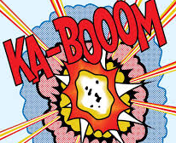
Increased power of big business
Bull Market
“Lost Generation” culture
Lack of government regulation
Credit
Consumerism

