Slide 1
Moving West:
1800s U.S. Western Expansion

Slide 2
Out into the vast unknown…
Mid 1800s: Everything past the Mississippi River was “frontier”
The trip west was difficult:
Limited resources
Water
Food
Wood
Mostly Farmers, but also Ranchers and Cowboys, Miners and Workers
Diverse population: Native Americans, African Americans, Mexican Americans, Chinese Immigrants, Irish Immigrants

Slide 3
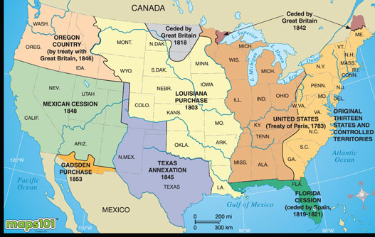

Slide 4
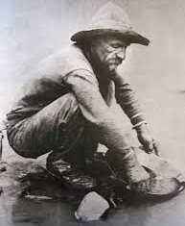
Miner 49er
1848 Sutter Mill in CA found gold
1849: 80k people “rush” to CA for gold (came from everywhere)
Called Forty-niners
CA pop in 1850 was 93k; 1860 was 380k
Most mined with pans & shovels because erosion washed away the rock that gold was in so it was now in rivers and streams
Tent camps popped up all over
Merchants followed
Would move from site to site; following the gold or silver

Slide 5
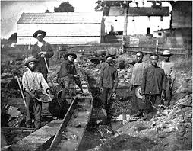

Slide 6
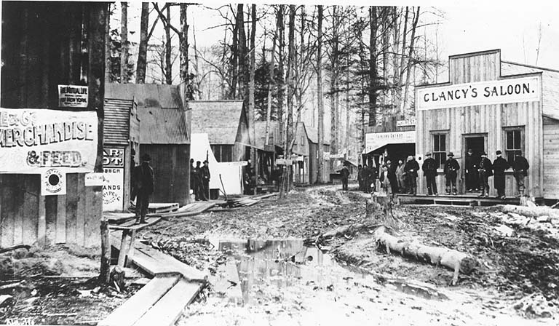
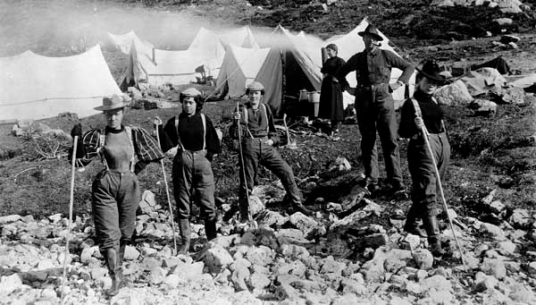

Slide 7
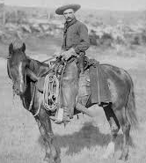
Rootin’ Tootin’ Cowboy!
Cattle because a lot of open range and prairie grasses for grazing
Wide open = no fences
Started in TX: Mexican Vasqueros were the original cowboys
Wore large brimmed hats and pointy toed boots and rode horses
Many ranchers left to fight in Civil War = cows left untended = unbranded
Leads to post war people claiming the cattle as their own and branding
25% of cowboys were African Americans and Mexicans
Cowboys drove cattle to cities in TX where the cows were loaded on trains and shipped to Chicago’s meat packers

Slide 9
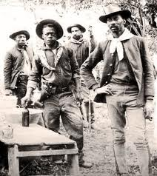
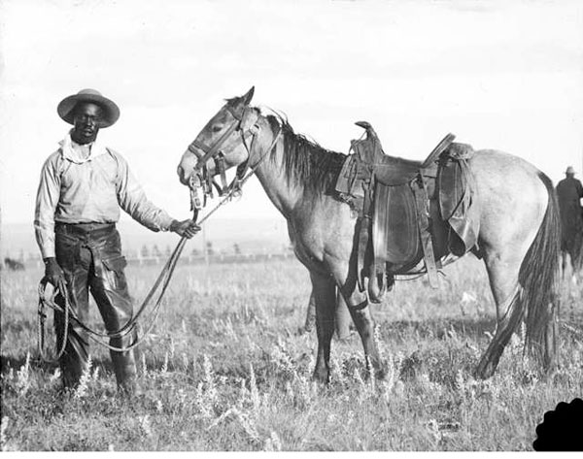

Slide 10
Chugga Chugga Choo Choo
Railroads pre-1850 were mostly short (regional)
1860 railroads went from Atlantic to Mississippi River
Gold rush meant a demand for transporting people and supplies west
Settlers wanted to get crops to market
All meant need for transcontinental railway system

Slide 12
Pacific Railway Act
Where to put it? North or south? Civil war made that decision easy.
Pacific Railway Act: Central Pacific and Union Pacific Railroad Companies were to join the east and west railways and put up telegraph lines
UP started at Nebraska and went west
CP started in Sacramento and went east
Met in Promontory Point, UT in 1869
Act allowed the government to give each company up 6400 acres and loans up to $48k/mile.
The companies could sell the land to settlers and use the money to pay back the gov’t loans

Slide 13
I’ve been working on the railroad…
Labor shortage: Civil War and Gold Rush
Post 1865: Civil War Veterans, ex-slaves, Irish and Chinese Immigrants
Irish discriminated against in eastern cities because poor and Catholic
Potato Famine in Ireland lead to large wave of Irish immigrants coming to the US
Railroad companies advertised in China for workers
1868 10k Chinese employed by railroads
Dealt with racism and discrimination
Lower wages

Slide 14
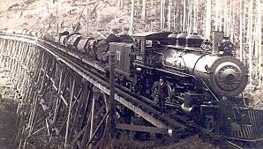
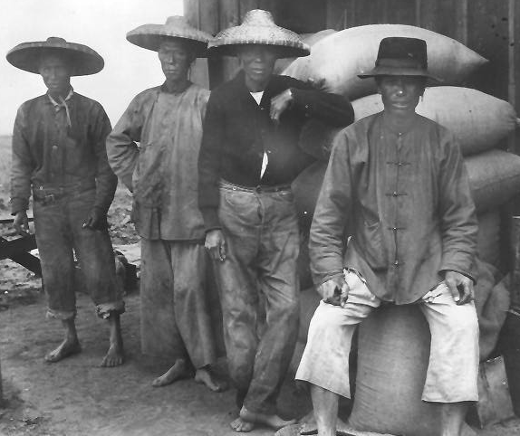

Slide 15
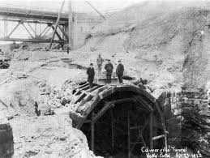
Railroad issues
Dangerous: workers used dynamite to build tunnels
Weather (mountains, desert, all seasons)
Native American attacks
High bridges
Displaced Native Americans because the railroads went through their territories
Terrain itself was difficult: Sierra Nevada Mountains, etc.

Slide 16
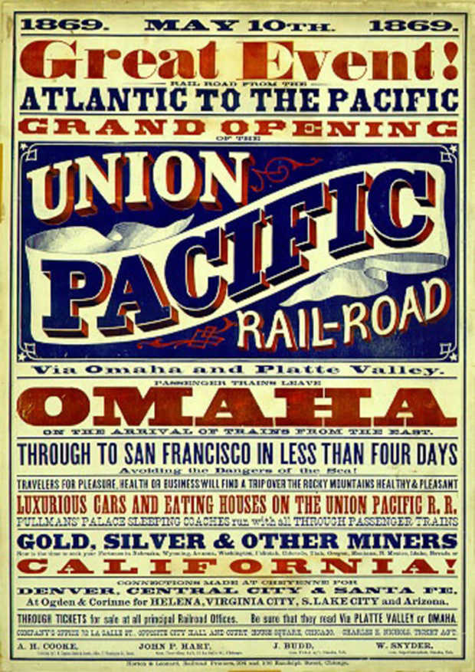
1858: Stage Coach from San Francisco to Missouri was $200 and took 22 days
1869 Train from San Francisco to New York was $70

Slide 17
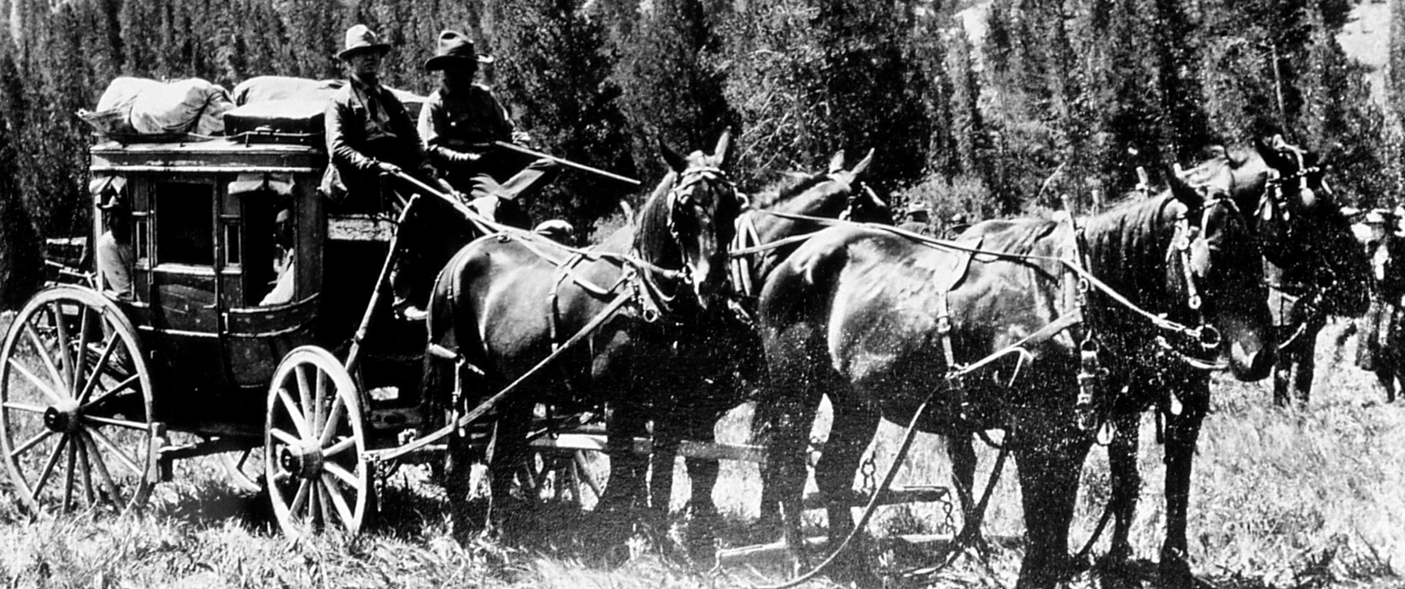
Worth it in the end??
Travel time went from 4 mo by wagon or coach to 10 days on a train
Lots of $$ made by railroad owners
Trade was easier for farmers, ranchers and industry
Communication was easier across the country

