Slide 1
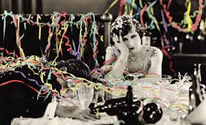
The Party’s Over
The Great Depression
The Great Depression Overview
FDR overview

Slide 2
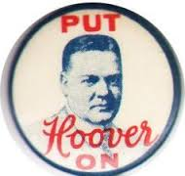
The Party That CAN’T End
1928:
Herbert Hoover elected president
Republican
Ride the prosperity wave
Coolidge tradition:
pro-prohibition
Small government
Isolationist
American “success” story
Orphan
Self made
Called “The Chief”
Integrity, humanitarianism, efficiency
“A chicken in every pot”

Slide 3
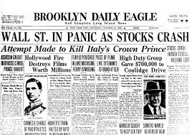
Last Call: The Beginning of “The Dirty Thirties”
Black Thurs 10/24/1929 – Dow dropped 11%
Friday, investors rallied and bought “blue chips” for temp relief
Black Monday 10/28/29 – margin calls, 13% drop
10/29/1929 Black Tuesday
Great Britain raises rates to attract investors
Selloff: 16.4m shares sold
By December – stockholders lost $40B
10/30/1929 – Rockefeller and Durant bought up shares to show their confidence in market, but not enough
Impacts world economy
Unemployment:
4m in 1930
12m in 1932
Bank failures: 5k collapsed by 1932
People lost savings

Slide 4
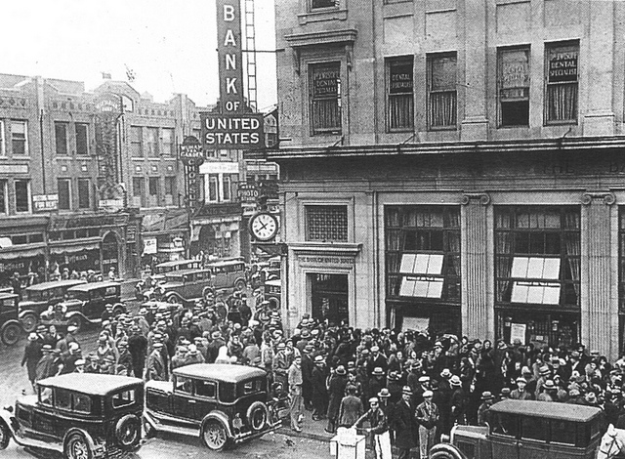

Slide 5
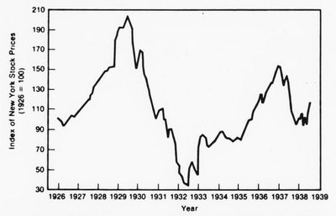

Slide 6
No money for investing
Businesses close
Can’t pay bills
Banks close
Lose savings
Lose jobs
Market Crashes

Slide 7
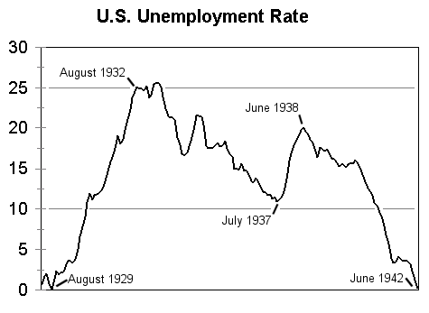

Slide 8
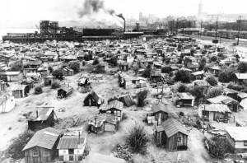
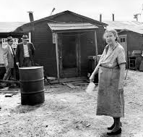
“we’re firing, not hiring”
Foreclosures
Breadlines
Soup kitchens
Suicides
Lower birth rate
Hoover blankets
Hoovervilles
1st in Seattle

Slide 9
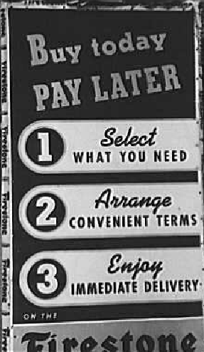
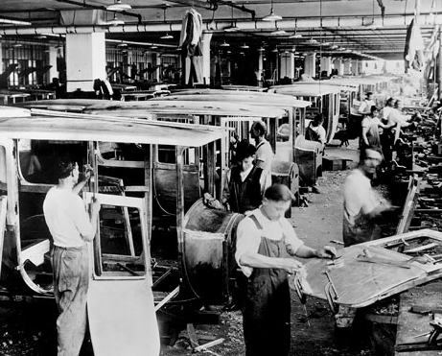
But how could this happen?
Technology/mechanization
Too much $ into too few hands
$ spent on capital, not labor
Credit
Weather
Abroad

Slide 10
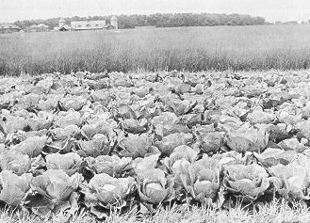
Hoover policies…
Thought prosperity endless
June 1929: Agriculture Marketing Act (pre-Crash)
Help farmers by creating cooperatives
Federal Farm Board created
loans to farms
Bought surpluses
1930: Hawley-Smoot Tariff
Raised duty on foreign goods (from 38% to 60%)

Slide 11
A good president for a different time
1920s
Conflicted: humanitarian BUT individualist
Reluctant about government assistance
Would make citizens weak
Did step in: Top down policy
Reconstruction Finance Corporation
RRs, banks, rural credit
$2.5B public works
Hoover Dam
Labor:
Norris – La-Guardia Anti-Injunction Act (1932)

Slide 12
Hoover Dam
1931-36
112 died
Between AZ and NV
Creates Lake Mead
Largest concrete structure at the time
Cost of $49M at time ($833M today)
Provides irrigation, hydro-electric power
Controls floods
5200 employees at height of construction:
1934 “Mongolians” banned
30 were most Blacks
Worked worst jobs

Slide 13
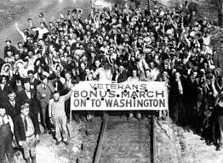
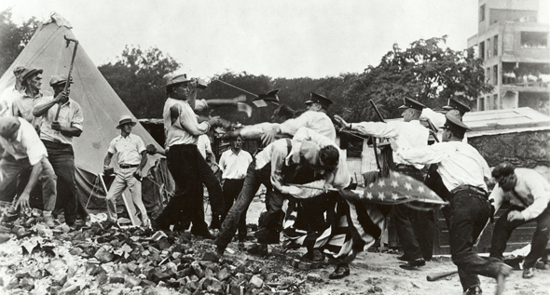
Bonus Army
WWI Veterans
Receive bonus payments in ‘45, but wanted now
Marched on Washington (1932)
20k
Failed to persuade Congress
Some paid by Hoover to go home
Riots
Accused of being criminals and Communists
Military used (Gen’l MacArthur)

Slide 14
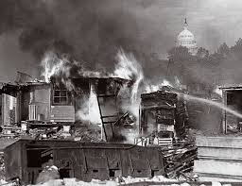
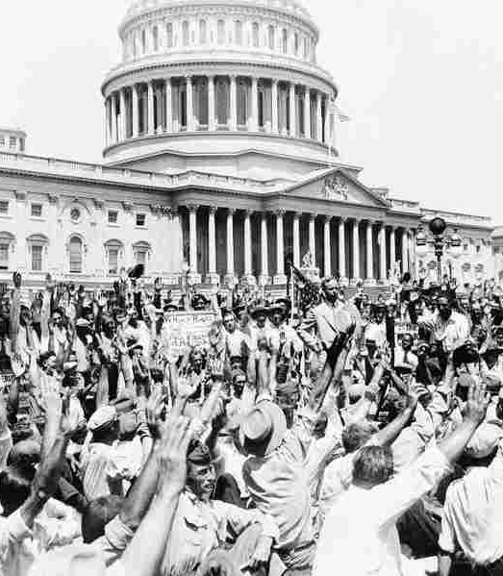
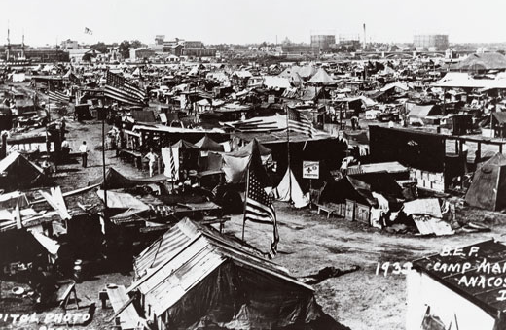

Slide 15
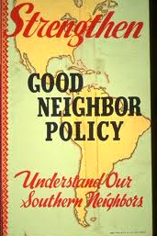
Hoover continued
Good Neighbor Policy
Not interventionist
Withdraw from South America
Sets attitude for future

Slide 16
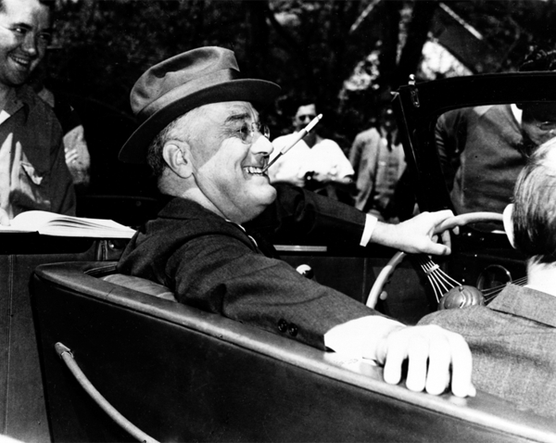
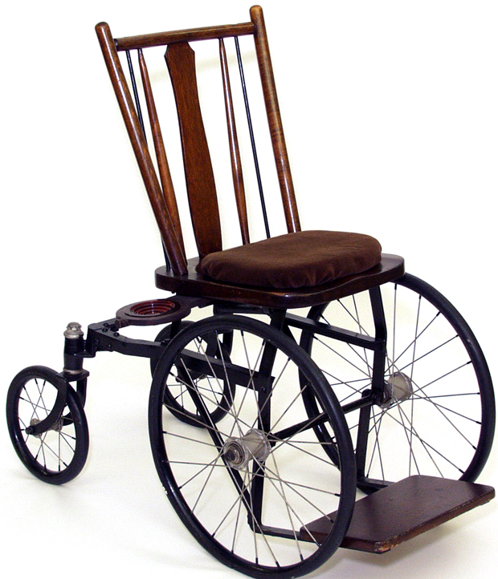
Franklin Delano Roosevelt
Governor of NY
Rich family (5th cousin of Theodore Roosevelt)
Harvard educated
1921 diagnosed with paralysis in legs
6’2”
Presence
Charm
Orator

Slide 17
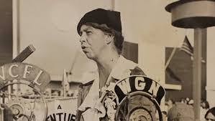
Eleanor Roosevelt
Niece of T. Roosevelt (distant cousin of FDR)
Strong, tall, active
Women’s Trade Union League
Established network of women reformers in D.C.
Most active First Lady
Fought for poor and oppressed
Rough marriage

Slide 18
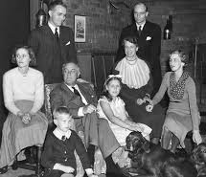
Personal Life of the Roosevelts
Mom: Sara Delano, Daughter of Chinese trade businessman (opium and tea)
James Roosevelt
Groton Boarding School, Harvard (History degree), Columbia Law
Social Register
Sara did not approve of Eleanor
Eleanor walked down aisle by Pres. T. Roosevelt (uncle)
Senate, Governor, V. Presidential candidate
6 kids

Slide 19
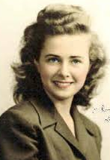
FDR’s “Indiscretions”
1914 Eleanor’s Social Secretary Lucy Mercer
Found out b/c saw letters during WWI between them
Ended it…
Called “Mrs. Johnson” by Secret Service
Was at his deathbed
His Private Secretary Marguerite “Missy” LeHand (20 yrs)
Possibly Princess Martha of Sweden (stayed in White House during WWII
Eleanor
Own house in Hyde Park, NY
Political Partnership

Slide 20
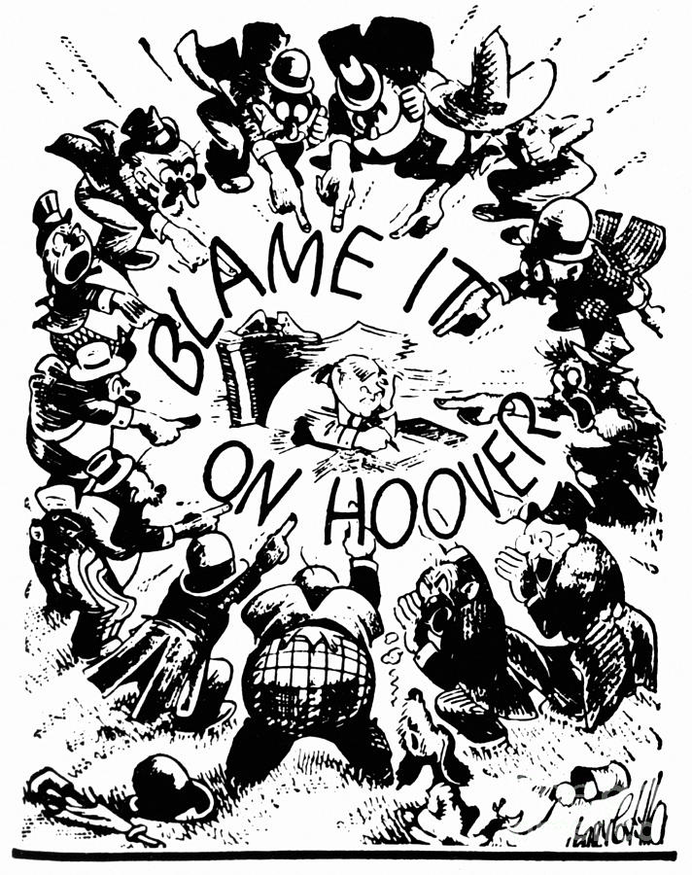
1932 Election
11M unemployed
Hoover’s top-down policies failed
FDR spoke of the “forgotten man”
Speeches written by “Brain Trust” (reformers, intellectuals)
“Happy Days Are Here Again”
Anti-debt (initially)
Landslide: 22.8m vs. 15.8m (472 vs 59 electoral votes)
Shift in Black voters from Republican (Party of Lincoln) to Democrat because of the “last hired, first fired” - they were worst off

Slide 21
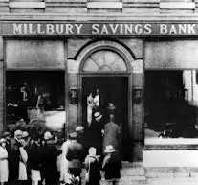
The only thing to fear…
Republicans feared inflation
Banks locked doors
Money hoarding
March 4, 1933: Inauguration
1933 FDR Inaugural Speech
“Hundred Days” – THE NEW DEAL BEGINS
Democrat-dominated Congress
3/6 – 6/16/1933
Emergency action legislation
3 Rs: Relief, Recovery, Reform
Short run (2yrs)
Long run (permanent)

Slide 22
New Dealers
Revived Progressive policies
German social insurance
English housing and garden
Danish agricultural recovery programs
WWI collectivism in US
Pro: Unemployment insurance, minimum wage, old-age insurance, labor reforms, national resource conservation

Slide 23
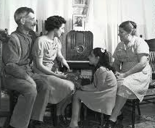
FDR as President
“Blank Check” powers by Congress
Intuition: any action (even bad) is better than none
Used radio
Fireside Chats
Told public to use banks, etc.
FDR “came into” peoples’ homes
Fireside chat #1

Slide 24
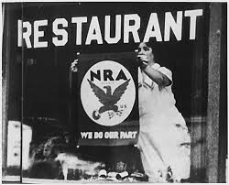
National Recovery Administration
Created by Emergency Congress
“Blue Eagles” – patriotism
Labor:
No child labor
Banned anti-union contracts
Guaranteed right to organize
Increased strikes and walkouts
Industry
Limit hours
Minimum wage
Unemployment

Slide 25
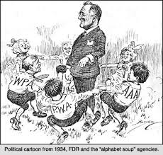
National Industrial Recovery Act
SEC
PWA
TVA
Executive Order 6102
Collin Harrison Act
21st Amendment

Slide 26
Bank Reform
Glass-Steagall Banking Reform Act
Created FDIC
$5k deposits insured
Tried to reduce hoarding
Ordered gold to be surrendered to Federal Reserve through Executive Order 6102
Took currency off of gold standard
Managed Currency (paper money)
Increased price of gold over time to increase $ in circulation ($20/oz to $35/oz)
Wanted inflation:
Help debtors
Stimulate economy (more $ to spend)
Faith in paper money
1934 gold standard used for international trade

Slide 27
Long Run Bank Reform
Federal Securities Act
Brokers have to disclose information
Created the SEC (Securities and Exchange Commission)
Watchdog
Public Utility Holding Companies Act
Prevent big business pyramids w/low capital from forming

Slide 28
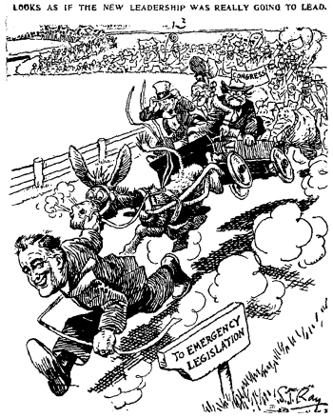
Economic Reforms
Emergency Banking Relief Act of 1933
Presidential power to regulate banking
Transactions
Exchange
Re-open banks

Slide 29
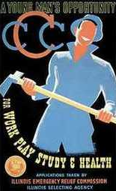
Job Creation
25%+ unemployed at height of Depression
CCC: Civilian Conservation Corps
Federal Emergency Relief Act
Goal: fight unemployment
AAA: Agriculture Adjustment Act
HOLC: Home Owners’ Loan Corp.
CWA: Civil Works Admin.
PWA: Public Works Admin.
Federal Trade Commission
Expanded Hoover’s Reconstruction Finance Corp

Slide 30
TVA: Tennessee Valley Authority
1933
Public utility: more people using electricity, more need, paid more
Public Holding Companies (big business) owned
Cheap or even public land
Water is a public resource
Put people to work
Government already owned some plants (Muscle Shoals) from WWI
TN Valley had lots of tributaries and eroded land: serviced 2.5M people
Determined “true cost” of electricity and used as a yard stick for water prices in the future

Slide 31
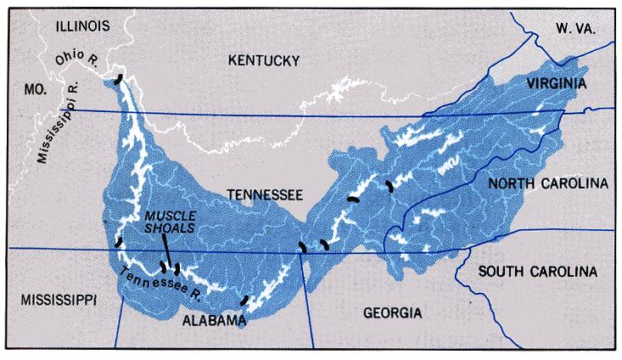

Slide 32
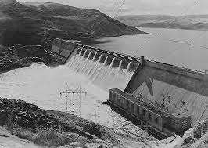
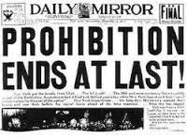
PWA: Public Works Admin
Long run goal: industry and unemployment relief
$4B for 34k projects
i.e. Grand Coulee Dam on Columbia River, WA
Biggest man-made structure since Great Wall
Liquor
Repealed Prohibition with ok for wine/beer
$5/barrel tax
21st Amendment passed 1933

Slide 33
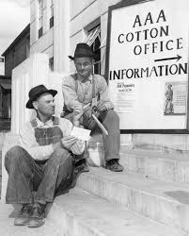
AAA: New Deal and Farmers
Created artificial scarcity
“parity prices”
Paid same price as would have received in 1909-1914
Paid farmers for surpluses
Plowed under crops/slaughtered livestock
“Subsidized Scarcity”
Withdrew acreage from farm use
= essentially paying farmers to NOT farm
Congress killed AAA in 1936
Failed: used taxes on processors to fund subsidies resulting in more unemployment (mill workers, etc.)
Replaced by Soil Conservation and Domestic Allotment Act ‘36
Paid farmers to plant soil conserving crops

Slide 34
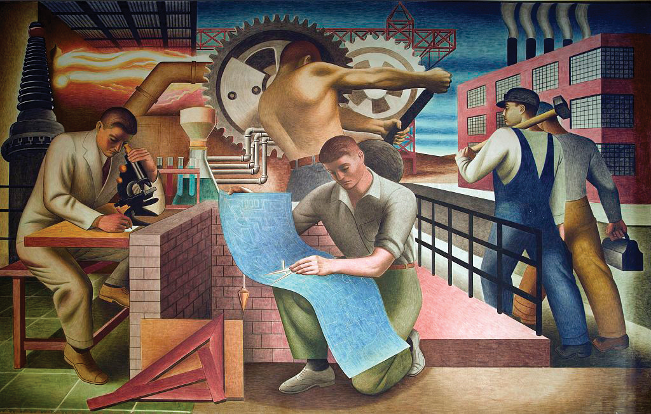
NRA: Destined to Fail
Limiting # of work hours
Goal to spread out work among more people
Cut pay for those who had the jobs
Replaced by Wagner Act ‘35
New National Labor Relations Board
Okay to self-organize
Bargaining
Lead to unskilled labor organizing
WPA: Works Progress Admin

Slide 35
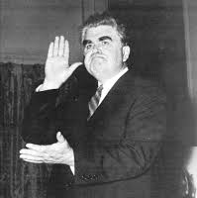
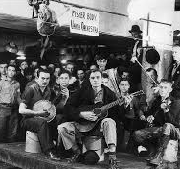
Committee for Industrial Organizations
Lead by John Lewis
Boss of United Mine Workers Union
1935 created
w/i the AFL (American Federation of Labor)
Unskilled labor
African Americans welcomed in
Race had been an issue for AFL
Divided – eventually broke from AFL and changed to Congress of Industrial Organizations
Moved into the auto industry
By 1940: 4m members (200k African American)

Slide 36
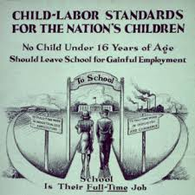
Fair Labor Standards Act 1938
Interstate commerce businesses
Minimum wage ($0.40/hr)
Maximum hours (40hr/wk)
No children under 16 can work
No children under 18 in dangerous jobs
Problems:
Excluded agriculture workers, service workers, domestics
Mexicans, Blacks and Women

Slide 37
Housing Reform
HOLC: Home Owner’s Refinancing Act (1933) creates Home Owner’s Loan Corp.
FHA (Federal Housing Admin) ‘34
Small loans to improve current homes or build new
US Housing Authority
Lend $ for low cost housing to communities
Built over 600k units, but not enough to meet needs
Protested by slumlords, real estate developers
Other housing acts: 3 year suspension on mortgage foreclosures
Resettlement Administration (reaction to Dust Bowl)
Farm-less families relocated to better land
CCC planted 200M trees on prairie

Slide 38
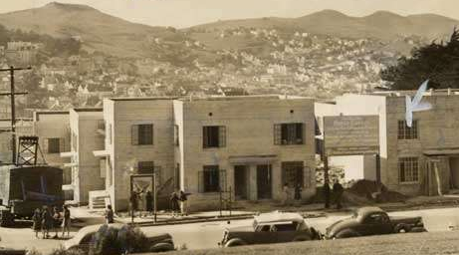

Slide 39
Social Security
1935 Social Security Act
Federal and state unemployment insurance
Old age insurance
Categories for retired workers (received $10-$85/mo retirement)
Funded by payroll tax (paid by employer and employee)
Idea from Europe
Pre-industrialization, farms were multi-generational
Rise in cities, less care for elderly (smaller family units)

Slide 40
Budget Cuts: Trying to Tackle the Deficit
Cuts
Military spending
Veterans’ benefits and pensions
Federal employee pay
Spending on education and research

Slide 41
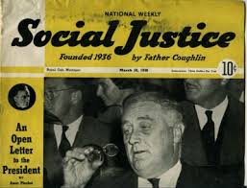
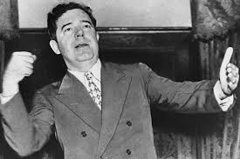
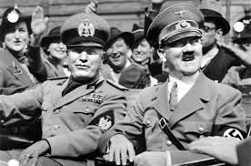
Extremists and Times of Trouble
Rise of “Demagogues”
Father Charles Coughlin
Senator Huey Long
Desperation in economic crisis…
Rise in fascism, extremism, autocracy
Europe: Germany, Italy
Asia: Japan

Slide 42
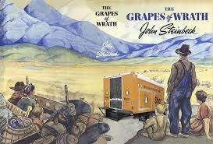
Signs of the Apocalypse: Dust Bowl Clip
Dust Bowl
1933 drought in Great Plains (E. Colorado to W. Missouri)
Rainless
Winds
Clouds of dusty top soil blocked the sun
7 yr old suffocated in KS
Man’s hand
Over farmed
Not great land to begin with
Disk plows
Exodus from OK and AK (350K) to San Joaquin Valley in CA (“Suitcase Farmers”)
Tough transition as immigrants Steinbeck’s Grapes of Wrath

Slide 43
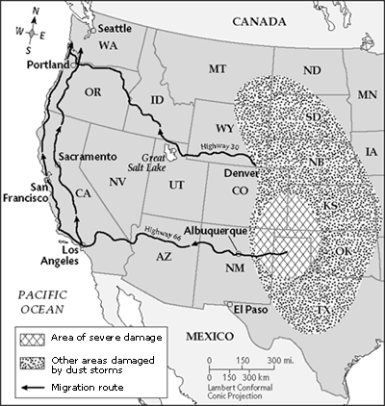
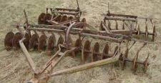
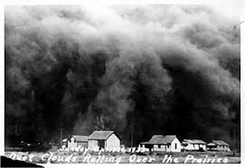

Slide 44
LAND AVAILABLE
CLIMATE
SUSTAINABLE
PRODUCTION
DROUGHTS
STORMS
QUALITY OF
LIFE
OKLAHOMA
MIGRATION
CONFLICT
GREAT
DEPRESSION
CALIFORNIA
ECONOMY

Slide 45
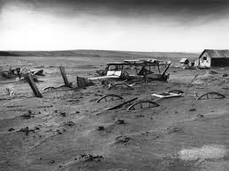
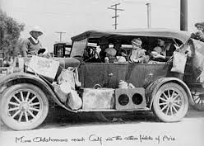
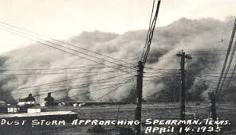
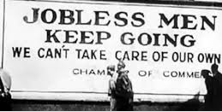

Slide 46
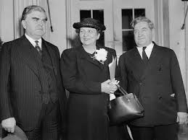
Rising Role of Women
Eleanor Roosevelt
Secretary of Labor Frances Perkins
Director of the Office of Minority Affairs Mary McLeod Bethune
Scientific strides:
Cultural Anthropology
Ruth Benedict
Margaret Mead
Literature
Pearl S. Buck

Slide 47
Native Americans
Indian Reorganization Act of 1934
Commissioner of Indian Affairs John Collier
Reversed forced assimilation polices from the Dawes Act 1887
Tribes to self-govern with local governments
Preserve traditions and culture
Not all supported: 200 tribes did; 77 didn’t
Fear of turning Native Americans into a “living museum”

Slide 48
1936 Election
FDR: The Champ of the “forgotten man”
Appealed to Blacks, urban people, immigrants, poor and women
Republican Alfred Landon
Moderate KS Governor
Ok with some of New Deal, not SS Act
Supported by Hoover and American Liberty League
FDR was a socialist
FDR sworn in 1/20/37; not March 4th
20th Amendment shortened pre-inauguration period

Slide 49
FDR’s Image is Marred
Supreme court
9 justices, conservative (4 by Harding)
Requests 6 more justices
Seen as court-packing
Undermining checks and balances
Results in conservative justices supporting some liberal policies

Slide 50
What’s the Deal?
1937 economic downturn
New Social Security taxes cut into payrolls
Focus had been to payoff war deficit
John Maynard Keynes
Economist
Okay for governments to run deficit
Embraced by FDR: turning point in economy
Use spending and fiscal policy to bolster economy
‘37 planned deficit spending

Slide 51
Changes in Congress
Congress was getting more conservative
FDR wanted to reorganize national administration
Seen as autocratic ambition
Hatch Act 1939
Stopped Federal Administrators from actively campaigning and soliciting for $ while in office
No fed funds for political purposes
No collecting $ from relief payments
Limits on campaign contributions and expenditures

Slide 52
Anti-New Deal Sentiments
1939
Waste, confusion, too many agencies created (bureaucracy)
Bitter businesses
Handouts
Depression not over
Leftist/communist Brain Trust
FDR is a Jewish sympathizer
Too much improvising
Broken promises
Debt went from $19.4B in 1932 to $40.4B in 1939

Slide 54
New Deal Supporters
Need for haste
Human “budget” vs. economic “budget”
Moral obligation (justified)
Actually helped Big Business
Deflected public anger
Rise in national debt seen as not b/c of New Deal, but because of WWII
Went to $258B in 1945
FDR preserved Democracy when the world was in economic crisis
Rest were going to extremes: fascism or socialism
Hamiltonian: pro big government
Jeffersonian: pro common man

