Slide 1
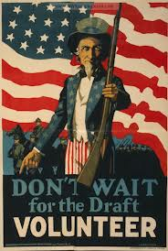
WWI
Peace Without Victory

Slide 2
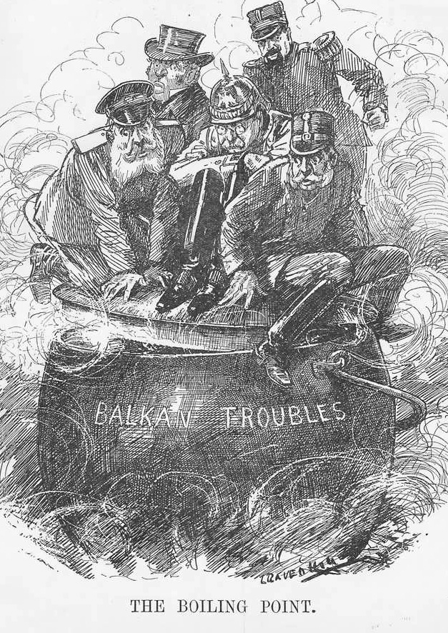
Tensions
Change in definition of “nation”
increased since the 1870s
Threat to minorities
Destabilization of empires
New measures of success
Economic
Competition in world

Slide 3
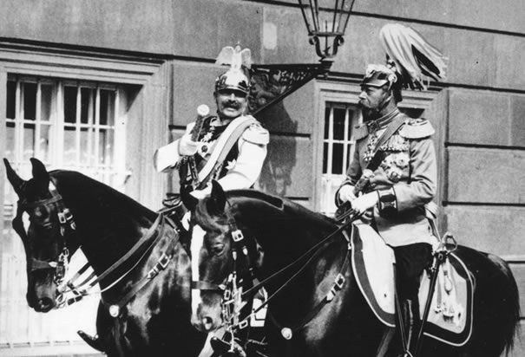
All relative…
Kaiser Wilhelm cousin of King George V and Czar Nicholas II…
Unrest: 1871 Germany takes Alsace-Lorraine from France; France wants back
Alliances had formed prior to 1914
Triple Alliance: Germany, Austria-Hungary, Italy
Triple Entente: France, Russia, England
During War:
Central Powers: Germany, AH, Ottoman Empire
Entente (Allies): France, Russia, England
Italy joined in 1915

Slide 4
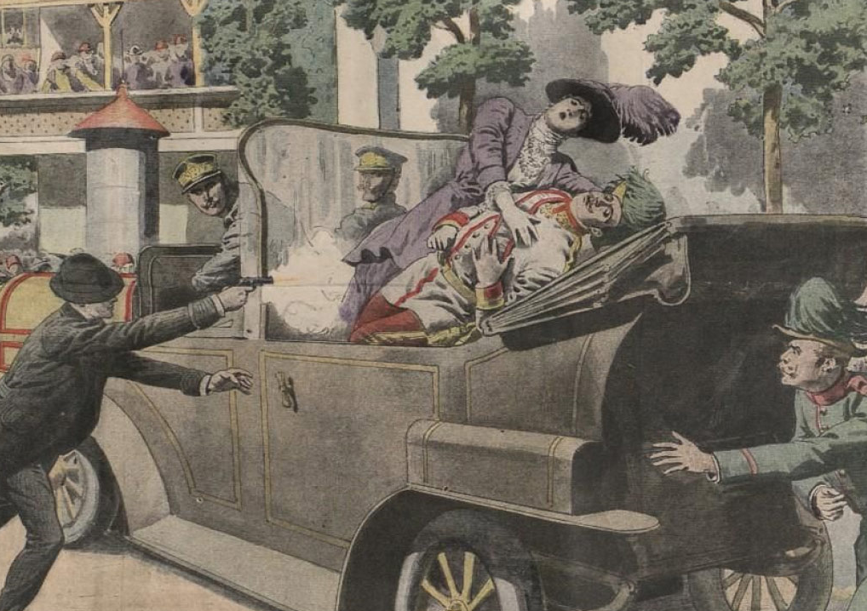
Travels end in tragedy
Archduke Franz Ferdinand and wife Sophie
Trip to Sarajevo (capital of province of Bosnia)
Serbia had become independent 1878
seen as threat to A-H Empire (an example to other ethnic groups in Balkans)
Wanted to gain territory (ethnic ties)
Gavrilo Princip (1 of 6 total) – wanted to break off of A-H

Slide 5
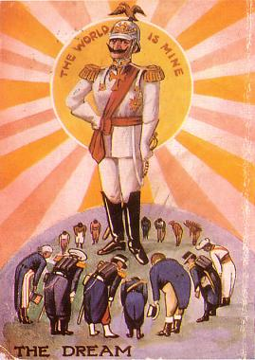
1 shot = War
Kaiser Wilhelm II of Germany
Supports A-H
Serbia doesn’t cooperate w/investigation
6/28/1914: Austria-Hungary declares war on Serbia
Chain reaction of alliances…

Slide 6
1.Serbia
Assassinates F. Ferdinand
2.A-H
Serbia doesn’t cooperate
Declares war
3.Russia
Comes to Serbia’s aid
Wilhelm demands investigation
4.Germany
Declares war Russia
5.France
Declares war on Germany
6.Germany
Declares war on Belgium (neutral)
7.GB
Declares war on Germany
8.US
Declares war on Germany

Slide 7
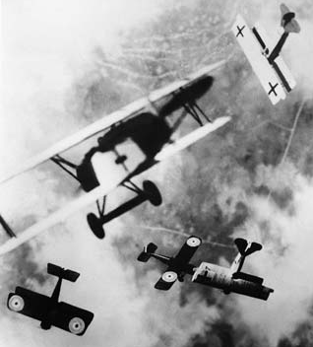
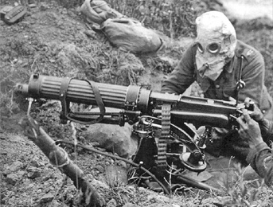
A different kind of (long) war
Trenches (450m of from Belgium coast to Switzerland)
Defensive vs. Offensive
“no man’s land” and “over the top”
Weapons
Machine guns (600 rounds in a minute)
Long range artillery (caused most casualties)
Poison gas
Technology
U-Boats
Zeppelins
Planes

Slide 8
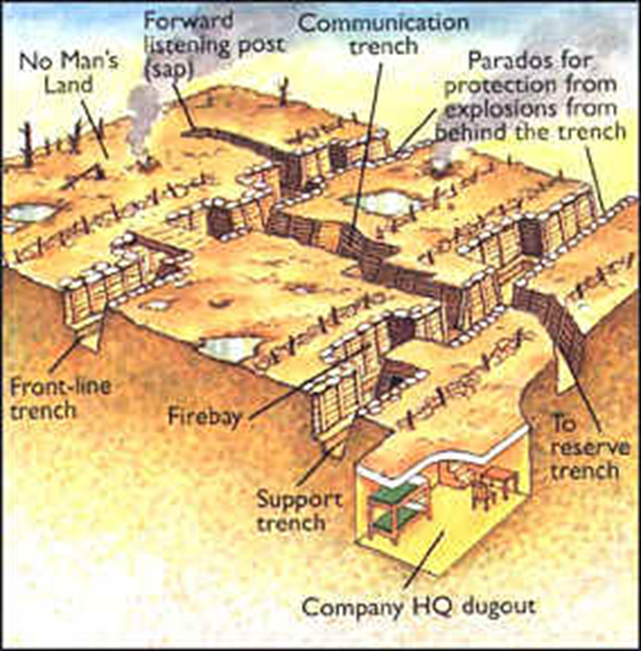
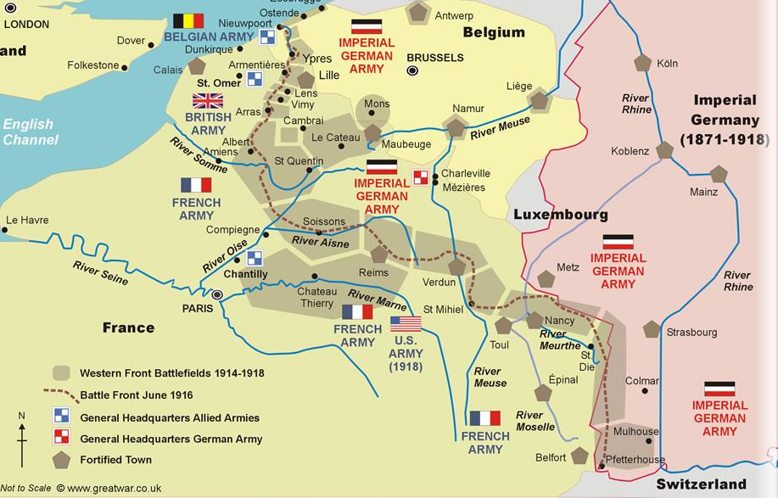

Slide 9
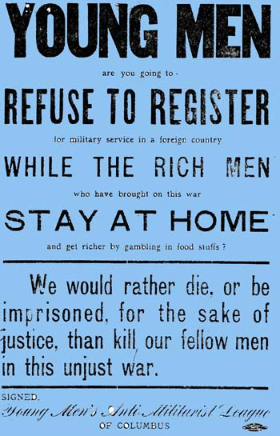
Not it…
Not our problem or business
Tradition of keeping out of Euro problems
ID as a melting pot (fear of American against American)
Loyalties split
1/3rd pop were immigrants
Many German, Irish (hated British), Italian, Jewish (Russia persecuted)
Native born population
Ties to England (trade)
Ties to France (helped with Rev. War)
Benefiting by the increased demand for goods by both sides

Slide 10
Country divided, yet again
Divided into 3 groups
Isolationists
Interventionists
Internationalists

Slide 11
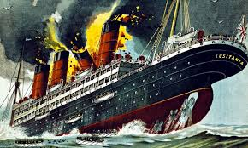
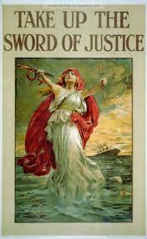
Straws in the camel’s back
German invasion of Belgium
German U-Boats used on merchant and passenger ships
5/7/1915 sunk British passenger ship Lusitania
1959 passengers
1198 dead
128 US
English blockade of English Channel (war zone of Atlantic; Med. Sea and Coast of Africa were also targets for U-Boats)

Slide 12
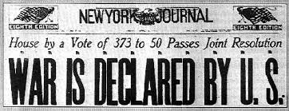
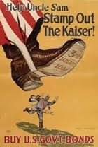
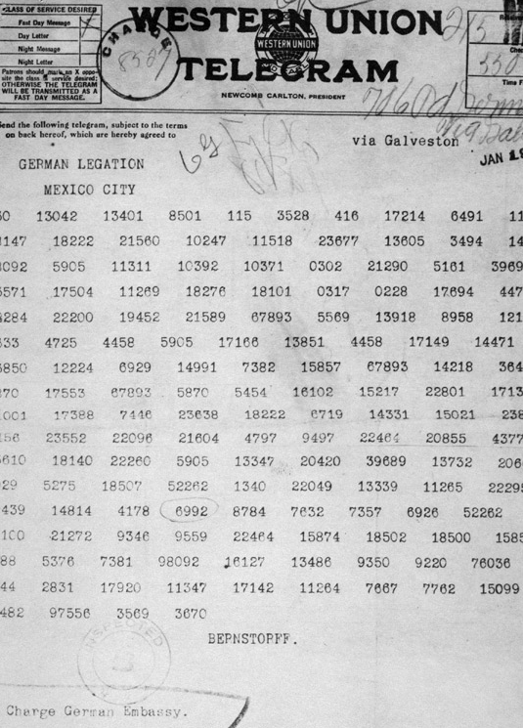
Wilson remained against getting involved
Begins preparations 1915
Fear that this would make it worse
National Defense Act and National Construction Act
Reelected (1916)
Trade was fine with GB and France
Because of blockade, US was not trading with Germany
Zimmerman Note to Mexico
4/2/1917 Asks Congress for Declaration of War
4/6/1917 Granted

Slide 13
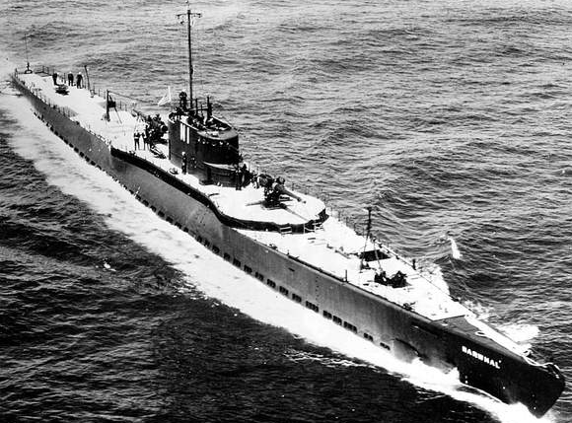
US Enters the war
Stalemate
High casualties
Tired
Fear of commitment by US troops (diverse)
U-Boats ramped up (more merchant ships)
Allies implement convoys w/warships
Japan involved in Pacific (anti-sub)
General Pershing: commander of US forces in Europe
6/1917 small number of soldiers: “Doughboys”
1918 more: fresh vs tired Germans

Slide 14
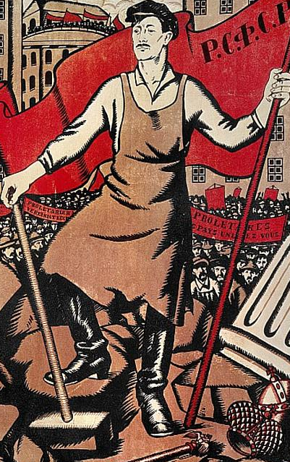
Russia bows out
Unrest since 1905
WWI put them against the Ottoman Empire = hurt trade routes
Revolution 1917
Provisional Government
Leon Trotsky and Vladimir Lenin
Bolsheviks take over
Civil War until 1922
Red Army (Bolsheviks) vs. White Army (Cossacks)
Lenin pulls out 3/1918: treaty with Germany
Won’t participate in war of imperialism
Germany doesn’t have to deal with war on eastern front

Slide 15
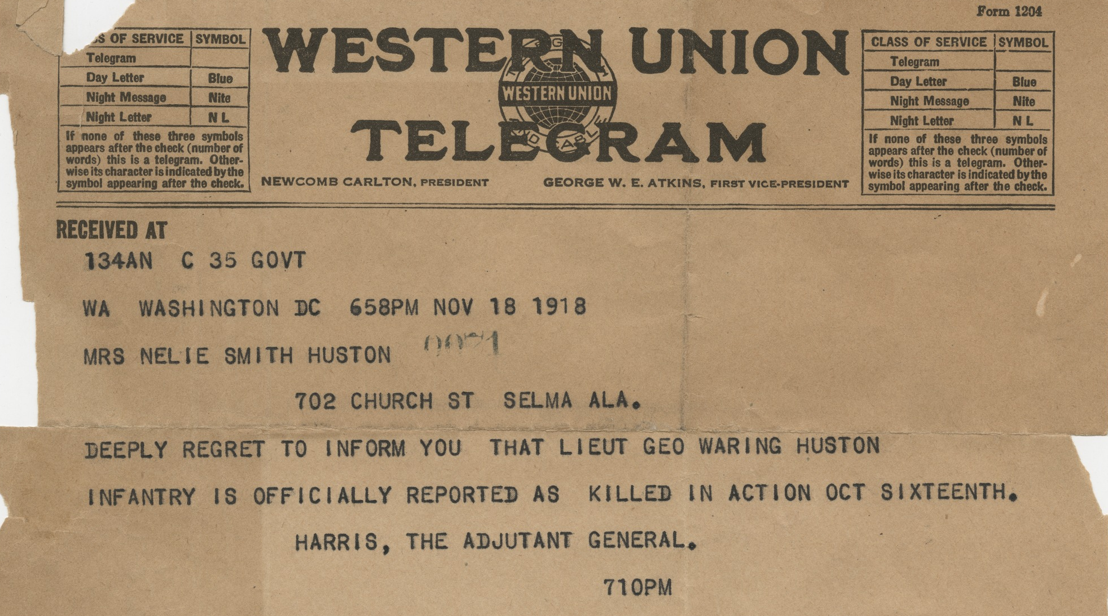
It’s over
11/11/1918 Germany surrenders
5 million Allied troops die
8 million Central Powers troops die
6.5 Civilians
U.S. sent 1.3 million soldiers; 50k die; 230k wounded

Slide 16
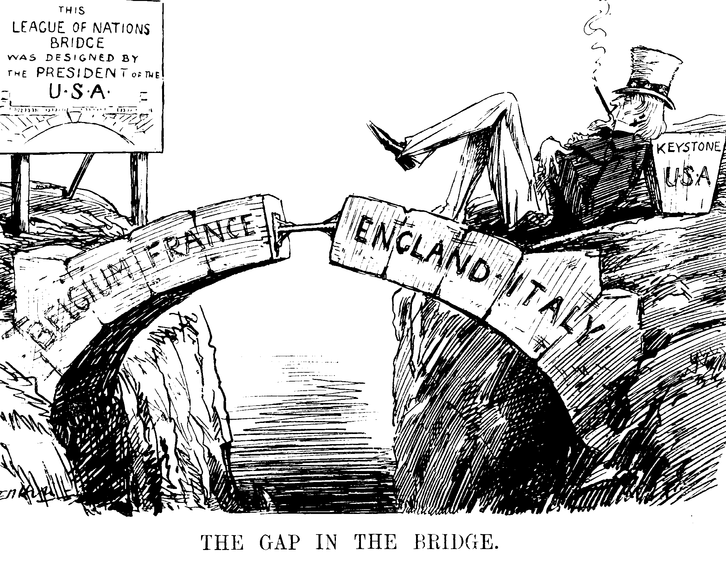
Wilson and peace
“Peace without victory”
Not imperialistic; about freedom
14 points
Goal of openness in treaties
Free trade
Reduction in arms
End colonialism/promote freedom
League of Nations: place for countries to reach peace and secure independence

Slide 17
Versailles Treaty
1919: Wilson is the 1st president to attend a meeting like this
Seen as idealistic; not an experienced diplomat
Allies:
Want reparations
Want peace AND victory
Alsace-Lorraine back to France
Not ok with 14 points, but ok with League of Nations
Territorial boundaries created that did not coincide with ethnic identities
Africa, Balkans, Middle East

Slide 18
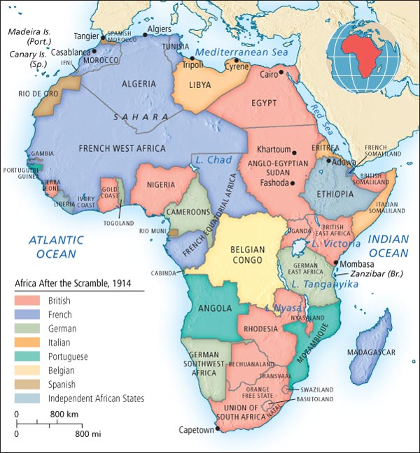
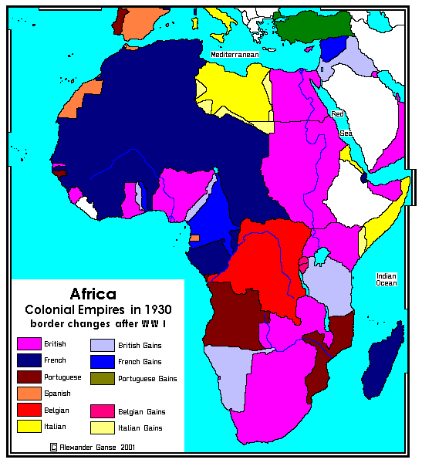

Slide 19
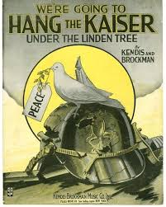
American issues with the treaty
Germans: it’s too harsh
Irish: no independence for Ireland
Should have stayed out
League of Nations: clause of alliance
Meant US could go to war without ok of Congress
Irreconcilables: anti-treaty
Reservationists: Henry Cabot Lodge (Republican Senator, anti-Wilson, pro-Imperialism, anti-Treaty as a threat to Sovereignty)

Slide 20
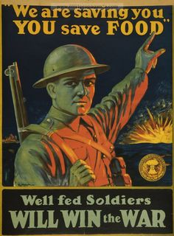
What was going on at home?
Selective Service Act: Draft
War Economy:
New Federal Agencies
Regulate food production, fuel, energy
Free trade sacrificed for war effort
War Industries Board
Citizens told to conserve

Slide 21
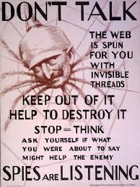
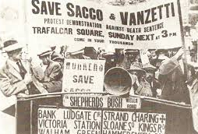
Eye Spy…
Espionage Act: Post office could ban “treasonable” mail
Sedition Act: no anti-American speech (repealed 1920)
Protestors, socialists, radicals included (jailed)
Draft dodging
Civil Liberties vs National Security
Propaganda
CPI
Prejudice fueled
Anti-German movement

Slide 22
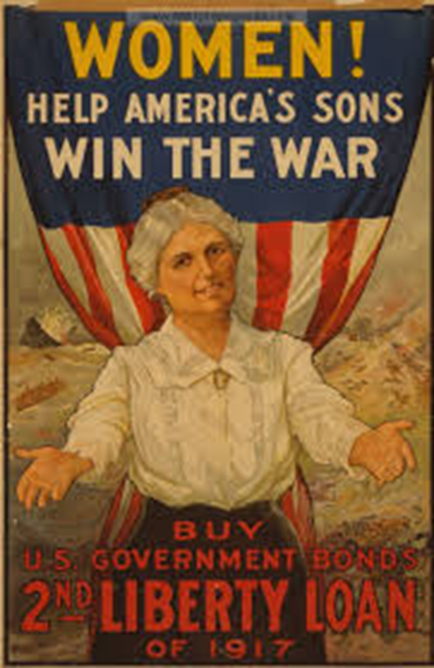
Changing roles
Women: 500k joined the workforce
Could vote in some states (not nationwide until 1920)
Women’s Hospital Service
Army Corps of Nurses
African Americans
Great Migration: 400k left south for northern factory jobs
367k joined the military
Hopes for equality at home, but not
Hispanics
Migration to south for jobs in agriculture (left by African Americans)
Form barrios in CA

Slide 23
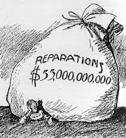
Post war: Europe
German reparations = $5B in hard currency (don’t have it)
Territorial disputes
Soviet Russia: fear of worker revolutions
No more monarchies
Empires done
England and France left weak
US as a thriving power

Slide 24
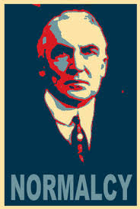
Post war: us
Economy: return of men meant shift in labor force for women and African Americans
Red Scare starts
Legacy of CPI/Espionage Act
Republican Warren Harding elected in 1920: Return to “Normalcy”
Rejects Wilson’s idealism
Richest country/highest industrial output
High demand for goods from Europe
Creditor Nation

